Slide 1
Mitigate DDoS attack in AWS Environment
Parag Kamra

Slide 2
#whoami
Parag Kamra
Senior Security Analyst at NII Consulting (Innovation and Research Team)
2.4 years of experience
Published whitepaper on Azure cloud Security Audit
Twitter: @paragkamra3

Slide 3
Agenda
Introduction to DDoS Attacks
DDoS Attack Statistics (Trends)
Types of DDoS Attack
How DDoS Attack Works (Demo Video)
Introduction to Amazon web services
AWS Services for DDoS Mitigation
Introduction to Auto Scaling
Demo

Slide 4
Introduction to DDoS Attack
A Distributed denial of service (DDoS) attack is an attempt to make an online service unavailable such as web servers, Game servers by overwhelming it with traffic from multiple sources

Slide 5
DDoS Statistics
DDoS Attacks in Q1 2017
China, South Korea and the US remained leaders in terms of both number of DDoS attacks and number of targets
The longest DDoS attack in Q1 2017 lasted for 120 hours – 59% shorter than the previous quarter’s maximum (292 hours). A total of 99.8% of attacks lasted less than 50 hours
For the first time in a year, activity by Windows-based botnets has exceeded that of Linux botnets, with their share increasing from 25% last quarter to 59.8% in Q1 2017

Slide 6
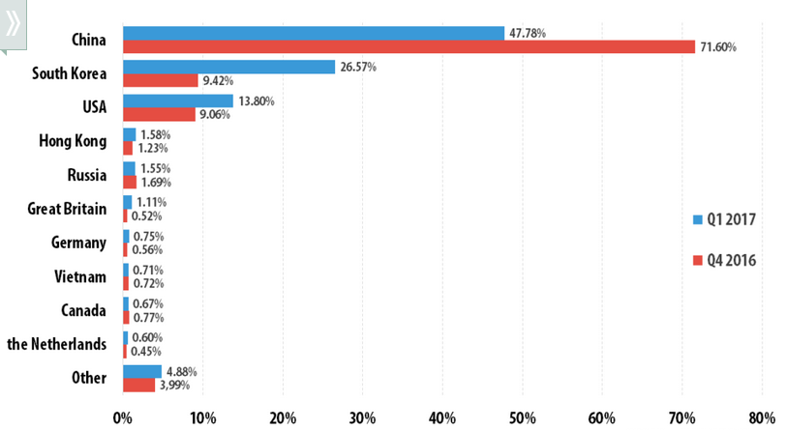
DDoS Attack Statistics
Geography of DDoS Attack (10 Most Targeted Countries in Q1 2017.)

Slide 7
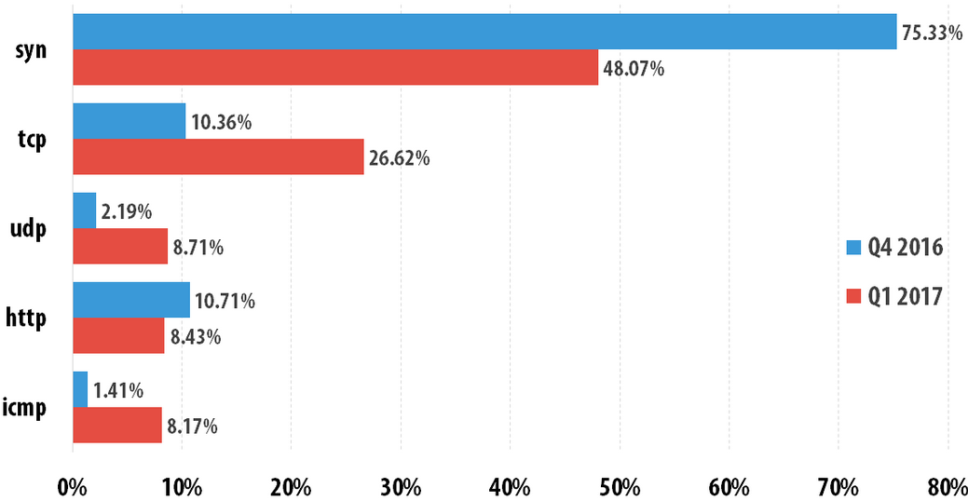
DDoS Attack Statistics (Cont…)
Types of DDoS Attacks in Q1 2017

Slide 8
Vectors of DDoS Attack
UDP Flood
UDP Reflection Attack (NTP)
TCP SYN Flood
Web Application Layer Attacks

Slide 9
DDoS Attacks can ….
Target Network with large volume of Traffic
Target Systems with large volumes of connections
Target Services with large volumes of requests

Slide 10
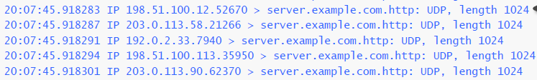
#Vector 1 UDP Flood
Network Traffic || System Connections || Service Requests
Clear indicator of Suspicious activity if destination doesn’t have UDP
Packet Size defined by Attacker

Slide 11
#Vector 2 UDP Reflection Attack
Network Traffic || System Connections || Service Requests
Attacker sends spoofed request to UDP service
Spoofed IP is that of the victim
UDP service responds with large payload

Slide 12
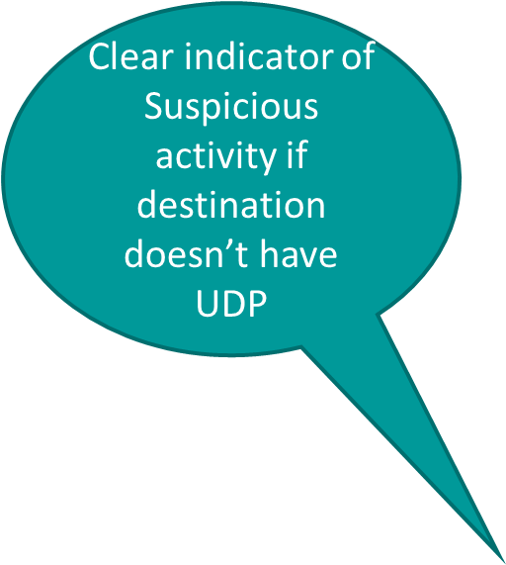
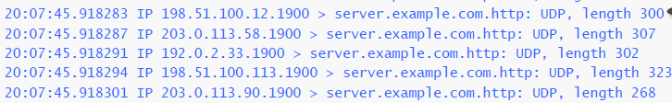
#Vector 2 UDP Reflection Attack
Network Traffic || System Connections || Service Requests
Large Packet Size (Flood of traffic is easy to generate)

Slide 13
#Vector 3 TCP SYN Flood
Network Traffic || System Connections || Service Requests
Flood of many connections targeting a system
Connections are left half-open, state table exhaustion

Slide 14
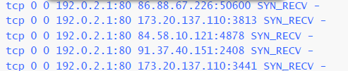
#Vector 3 TCP SYN Flood
Network Traffic || System Connections || Service Requests
Half open connection

Slide 15
#Vector 4 Web Application layer Attacks
Network Traffic || System Connections || Service Requests
Malicious web requests that look like real users
Impact availability or scrape site content
Mitigate using a WAF
Block abusive IP’s, user agents, etc.

Slide 16
DEMO Video of DDoS attack

Slide 17
AWS Services for DDoS Mitigation
Amazon Route53
Amazon Cloud Front
Amazon Cloud Watch
Elastic load balancing
VPCs and Security Groups
AWS WAF

Slide 18

Amazon Route53
One of the most common targets of DDoS attacks is the Domain Name System (DNS). Amazon Route 53 is a highly available and scalable DNS service designed to route end users to infrastructure running inside or outside of AWS. Route 53 makes it possible to manage traffic globally through a variety of routing types, and provides out-of-the-box shuffle sharding and Anycast routing capabilities to protect domain names from DNS-based DDoS attacks.

Slide 19
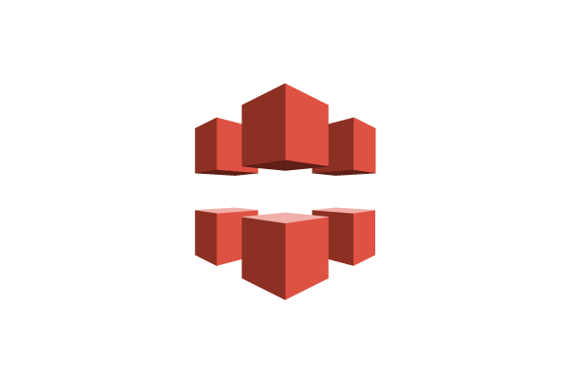
Amazon Cloud Front
Amazon CloudFront distributes traffic across multiple Points of Presence (PoP) locations and filters requests to ensure that only valid HTTP(S) requests will be forwarded to backend hosts. CloudFront also supports geo restriction, also known as geoblocking, which can be useful for isolating attacks originating from a particular geographic location.

Slide 20

Amazon Cloud Watch
Amazon CloudWatch is a component of Amazon Web Services (AWS) that provides monitoring for AWS resources and the customer applications running on the cloud

Slide 21

Elastic load balancing
Elastic Load Balancing (ELB) enables the automatic distribution of application traffic to several Amazon Elastic Compute Cloud (Amazon EC2) instances across multiple Availability Zones, which minimizes the risk of overloading a single EC2 instance. Elastic Load Balancing, like CloudFront, only supports valid TCP requests, so DDoS attacks such as UDP and SYN floods are not able to reach EC2 instances. It also offers a single point of management and can serve as a line of defense between the Internet and your backend, private EC2 instances.

Slide 22

VPCs and Security Groups
Amazon Virtual Private Cloud (Amazon VPC) allows customers to configure subnet routes, public IP addresses, security groups, and network access control lists in order to minimize application attack surfaces. ELB load balancers and EC2 instance security groups can be configured to allow only traffic that originates from specific IP addresses, such as that from CloudFront or AWS WAF, protecting backend application components from a direct attack.

Slide 23

AWS WAF
AWS WAF is a web application firewall that helps protect your web applications from common web exploits that could affect application availability, compromise security, or consume excessive resources. AWS WAF gives you control over which traffic to allow or block to your web applications by defining customizable web security rules.

Slide 24
Introduction to Auto Scaling
Auto Scaling helps you maintain application availability and allows you to scale your Amazon EC2 capacity up or down automatically according to conditions you define. You can use Auto Scaling to help ensure that you are running your desired number of Amazon EC2 instances. Auto Scaling can also automatically increase the number of Amazon EC2 instances during demand spikes to maintain performance and decrease capacity during lulls to reduce costs

Slide 25
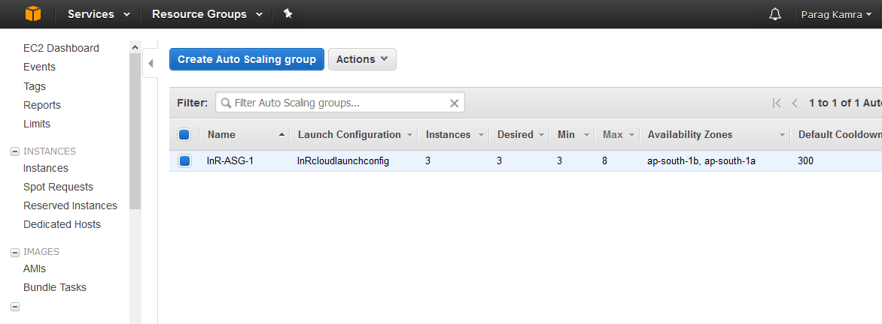
Auto Scaling

Slide 26
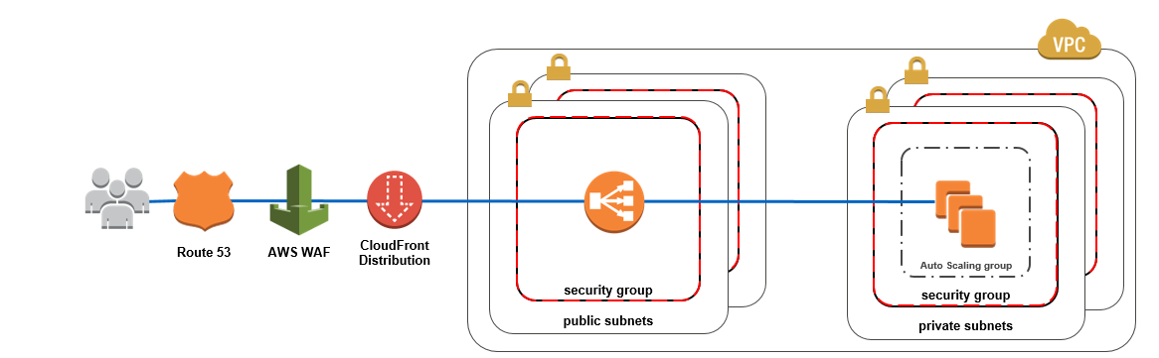
Mitigation approaches of DDoS attack in AWS Environment
Web

Slide 27
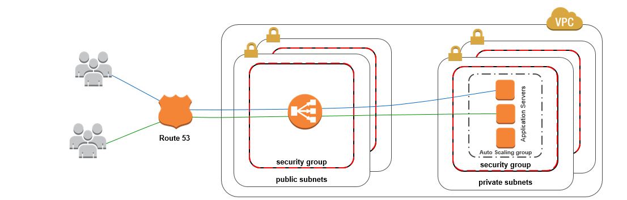
Mitigation approaches of DDoS attack in AWS Environment
Non web and load balanceable

Slide 28
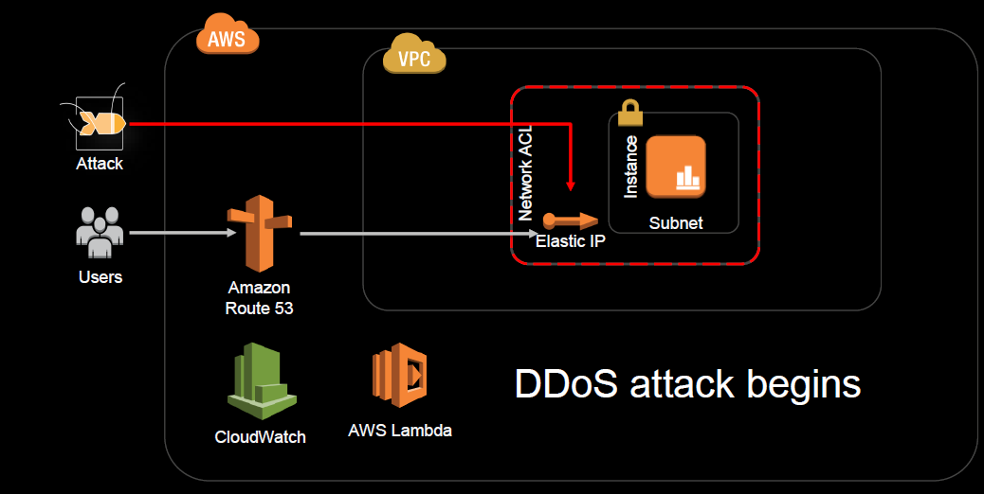
DDoS Attack Mitigation using Automation

Slide 29
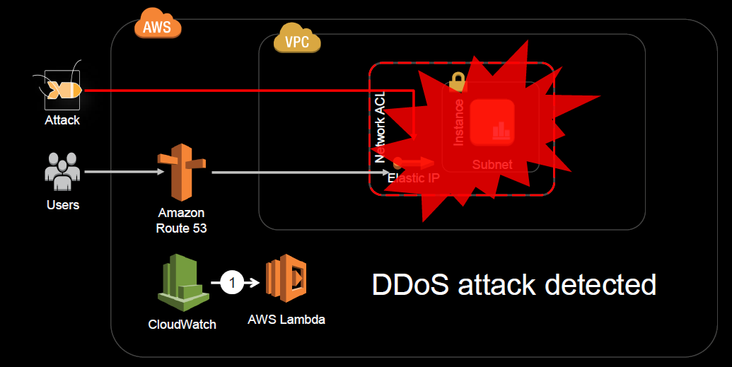
DDoS Attack Mitigation using Automation

Slide 30
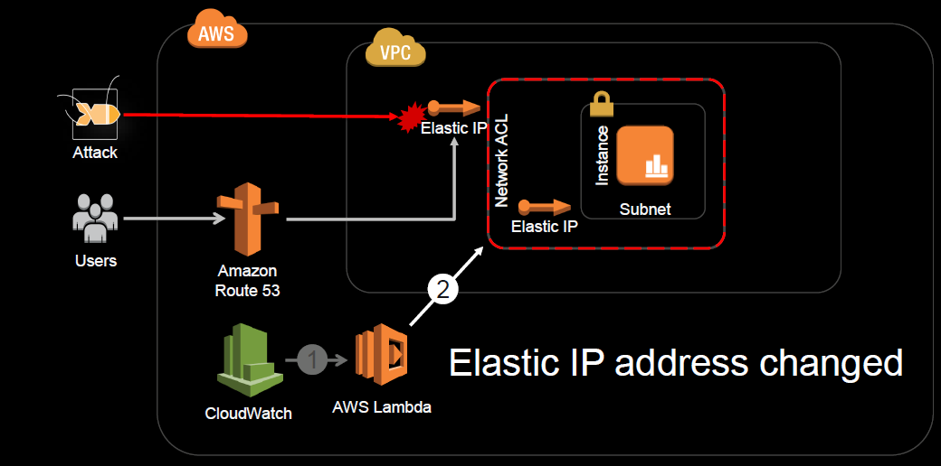
DDoS Attack Mitigation using Automation

Slide 31
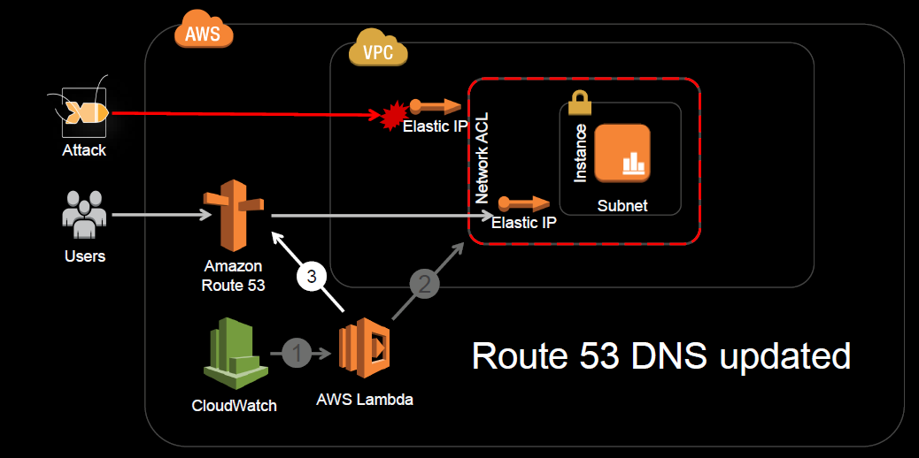
DDoS Attack Mitigation using Automation

Slide 32
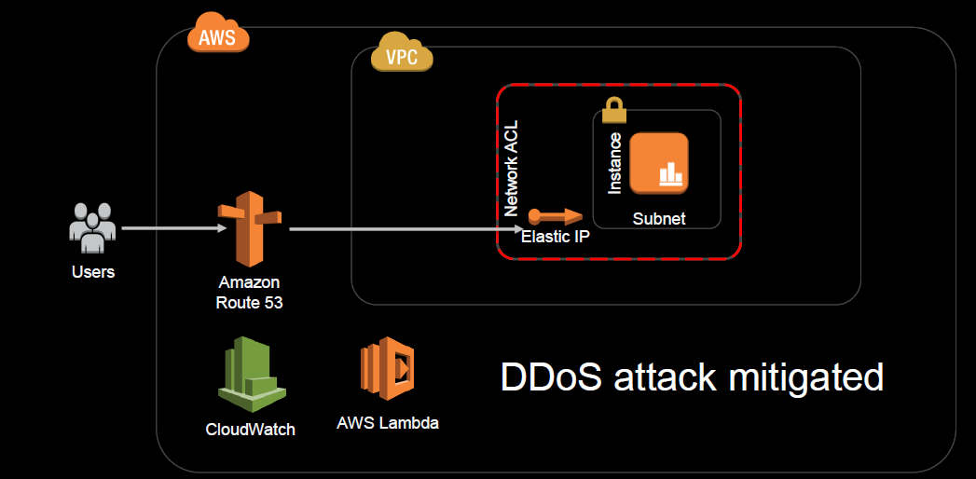
DDoS Attack Mitigation using Automation

Slide 33

DEMO

Slide 34
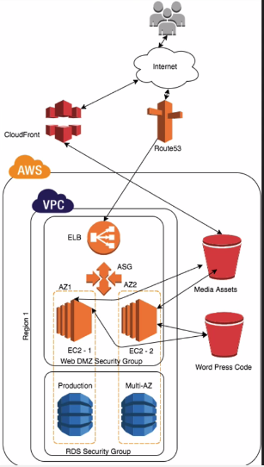
My AWS WordPress Application Architecture

Slide 35


Slide 36
References
https://aws.amazon.com/blogs/security/how-to-help-prepare-for-ddos-attacks-by-reducing-your-attack-surface/
DDoS White Paper from AWS https://d0.awsstatic.com/whitepapers/DDoS_White_Paper_June2015.pdf
https://aws.amazon.com/blogs/security/how-to-protect-your-web-application-against-ddos-attacks-by-using-amazon-route-53-and-a-content-delivery-network/
Azure Cloud Security Audit using PowerShell ( it’s my paper ☺ ) https://dl.packetstormsecurity.net/papers/general/msazure-audit.pdf

